Slide 1
Systems Modernization Project
OCM and Training Plan
Eugene Deloatch
OCM Workstream Lead

Slide 2
OCM & Training Objective
Prepare Loudoun Water for the implementation of SAP in alignment with objectives and expectations

Slide 3

Executive Objectives
The Challenge
Leverage technology to optimize Loudoun Water’s business practices
Our Immediate Objectives
Replace MUNIS and Hansen with a flexible, expandable, integrated enterprise software application
Re-engineer core business processes
Integrate with other business systems (e.g., AMI)
Facilitate other Strategic Plan initiatives such as Mobile Work Management, Business Intelligence, Asset Management, E-Commerce, etc.

Slide 4
Executive Expectations
  Expectations
Go-live On Time
Close the project On Budget
Go-live & prospects create Excitement
System is Utilized and Maximized (long term) and not bypassed
Preparation and Go-live cause No Frustration
There is No Disappointment post Go-live
Minimize Surprise Factor
Positive Impact for Customers
Essential and Immediate Focus… Employees who are engaged, can get their work done, and have help available during and after Go-live
In the long term… Grow with the system and become more efficient and effective
Page 4

Slide 5
Approach to OCM

Slide 6
OCM Summary
  Summarized OCM Approach
Achieve Organizational readiness
Activate Business Readiness Team
Select Super Users for each process area
OCM activities led by OCM workstream lead
Leadership helping to drive communication
Communications list created and disseminated
Impact Mapping: What has occurred and what will occur
“How to” and “What to do” steps to minimize org impact
Page 6

Slide 7
Getting the People Ready: OCM Basics
OCM Core Activities
Communication
& Leadership
Impact
Mapping
End User Training
Transition
Planning
Readiness Monitoring
Notes:
There are 4 components that contribute to building organizational readiness. The Roadmap provides accelerators for all of these elements.
Communications/Leadership: what, why, when, how, told by people who have credibility in the organization.
Impact Mapping: You can’t manage or communicate change if you don’t know exactly what the change will be. Impact Mapping identifies what will change. It is a central because it feeds all of the other aspects of OCM, as well as end-user training requirements
Transition Planning : How do we ensure a smooth transition from the old systems and processes to the new. Addresses transition in business operations as well as individual workloads, roles and responsibilities.
OCM processes interact with end-user training in the following ways:
Impact mapping and transition planning determine who should attend what training and when
Communications from the leadership of the organization messages ensure that adequate training is planned and that employees are encouraged to take it.
Readiness Monitoring is about making sure that OCM & End User Training are carried out and are effective
The focus of OCM in the SAP Focus methodology is on building readiness for the new system. Cultural change interventions, business process reengineering or organizational development activities may be used in parallel but are not addressed by the methodology.

Slide 8
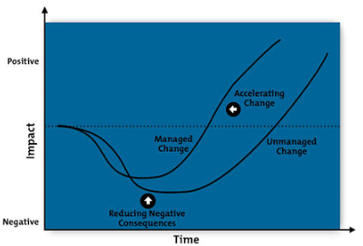
Why OCM?
Implementing sound OCM practices allows Loudoun Water to manage resistance to change and increase return on investment

Slide 9
Organization Readiness
Employees will gain interest, knowledge, and motivation during execution of the OCM Program. It is important to assess progress towards change across project phases. Numbers in brackets indicate number of assessments recommended per phase.
Sustainability
Employees support the adoption of SysMod by their teams, reinforce the new ways of working.
Adoption of New Behaviors
End of Hypercare
Confidence & Competence
Employees are able to work with the new system and support the changes SysMod requires.
Communication, Participation,
& Training
Go-Live
Training (1)
Realization (1), UAT (2)
Knowledge & Experience
Employees know how SysMod will specifically impact them, their customers, and their teams. Significant level is required prior to attending training.
Communication & Participation
Now
Awareness
Employees understand the “why” of SysMod.
Understanding & Desire
Employees understand the “what” and benefits of SysMod; they are interested in being advocates. Motivation increases.
Page 9

Slide 10
Business Readiness Team
The Business Readiness Team’s purpose is to identify, communicate, and manage; people, processes, and system activities/changes related to SAP go live
BRT Charter and Plan revised as of January 7, 2014
Some tasks include:
  Establish support model and procedures for Post SAP go-live
  Identify new roles and create assignments (e.g. EAM Planners)
  Identify and enact changes to rates, rules, and regulations
  Establish communications for external customers

Slide 11
Super Users
Designating Super Users allows the dissemination of knowledge to a broader audience more quickly and provides employees with another avenue to find answers to questions or issues
Next steps:
  Target and onboard Super Users in February 2014
  Super Users will begin to participate in Business Process Procedure reviews, upcoming Testing activities, and training pilot sessions
  Super Users will be made up of LW employees not already assigned as part of the Core Project Team
  Coordinating with Directors/Managers to assign Super Users from their respective departments

Slide 12
OCM Program Management
OCM Workstream Lead: On boarded in October 2013
Upcoming activities:
  Work closely with consultant Training Lead to conduct overview & navigation sessions, BPP reviews, townhall sessions, and training documentation development
  Work with Executive team to communicate effective messaging to the LW staff with ongoing project activities
  Help provide guidance to the Project team with training related activities and deliverables
  Release monthly newsletter discussing project activities and updates
  Coordinate training that ensures all system users have adequate level of knowledge of computer skills and integration points in SAP
  Implement coaching and pilot training sessions specifically tailored to each department
  Provide continuous workshops and coaching sessions post-go-live to reinforce gained knowledge

Slide 13
Communication as a Primary Readiness Tool
Awareness
Desire
Confidence & Competence
Understanding
Knowledge & Experience
Communication is typically used to set up or provide a foundational base for Education and Training.
For Loudoun Water, Communication is to be used to also deliver the Education portion of Training – both early and often.
Go-live On Time
Close the project On Budget
Go-live & prospects create Excitement
Utilized and not bypassed
Preparation and Go-live cause No Frustration
There is No Disappointment post Go-live
Minimize Surprise Factor
Have Positive Impact for Customers
Communications Goal
Page 13

Slide 14
Communication & Leadership
What to say, to whom, when, and how
The medium is the message: senior and middle management demonstrate leadership and commitment by
  Reinforcing key messages
  Listening and addressing employee concerns
  Helping make staff and operations ready for the new system.
Communication and leadership are done in four cycles: project kickoff, realization, final preparation, and go-live
Notes:
Information is one-way, communication is two-way
Hearing something from a manager you respect is a lot more credible than from a junior employee or an external consultant
Important information needs to be repeated, saying it once is not enough. You are much more likely to undercommuncate than overcommunicate
In the absence of information, people usually assume the worst. This is how rumors get started.
Analogies and metaphors are powerful tools, especially for communicating about intangibles such as business processes (ex. Moving into a high end manufactured home, with the compromises and stress it involves)
Be honest and truthful in your communications: it sets the right expectations. Don’t be afraid of saying that projects such as this can be difficult at times

Slide 15
Communications List

Slide 16
Impact Mapping & Transition Planning
Understanding what will change (and what will not) & planning the transition
  You can’t manage what you don’t understand
  Once changes are known (and understood) transition actions should be defined by local managers (with the help of OCM/Training team)
Impact mapping feeds
  Communication (”tell me what will change”)
  Transition planning (“how do we prepare”)
  End-user training (“who needs to learn what”).
Occurs in two cycles
  Cycle 1: high-level or “macro” impacts of new business processes, areas of greatest impacts, key benefits (Project Team)
  Cycle 2: impacts on local departments and individual responsibilities and local action plans (Project Team or OCM/Training Team + Managers)
Notes:
Even though macro impact mapping (Cycle 1) is positioned during the Realization phase, it can be initiated earlier, even during pre-project activities. The main goal is to identify the areas of the business which will have to undergo the greatest amount of change. These areas tend to be where benefits expectations are the greatest, thus requiring the highest degree of management attention.

Slide 17
Cycle One
What has occurred thus far:
  Org Readiness Assessment completed in 2012 and updated in 2013
  Change Impact Assessment and Analysis done during Blueprint Phase
  Workforce Transition plan devised during Blueprint Phase

Slide 18
Cycle Two
Upcoming activities that address departmental and individual responsibilities:
  Create training documentation and conduct training classes that discuss impacts and changes
  Organize personalized system walk thru sessions for areas of the organization with the greatest impact prior to end user training sessions (e.g. Lunch & Learn sessions)
  Disseminate communications throughout the life of the project continually discussing impacts

Slide 19

How to React (1)
1. Denial - Inform
  Confront individuals with information:
    Outline consequences, for example, when old systems are terminated
    Explain expected actions
  Allow time for individuals to consider implications and arrange follow up discussion
2. Resistance - Support
  Listen and acknowledge feelings
  Respond empathetically, encourage and support
  Refer individuals to user procedures and training notes to help them become familiar and confident with new day-to-day processes

Slide 20
How to React (2)
3. Exploration - Encourage
  Concentrate on setting priorities and short term goals
  Conduct planning and review sessions
  Encourage suggestions for future development
4. Acceptance - Facilitate
  Acknowledge and recognize those responding positively to change
  Set long term goals

Slide 21
What To Do ?
Prepare your team before Go Live
  Share information
  Collect feedback
  Discuss changes.
  Make education and training available
  Assess/monitor readiness of your team
Interact with the project team
  Ask the OCM/Training Team for information and for help where required
  Provide information to the OCM/Training Team about your team’s readiness

Slide 22
What To Do ?
Maintain change after Go Live
  Coach and support
  Encourage learning from each other
  Remain positive
  Reinforce behavior
Interact with other managers
  Share experiences and learning points with other managers
  Ask for help and advice/escalate issues where necessary

Slide 23
Approach to Training

Slide 24
Training Summary
  Summarized Training Approach
Implement sound training & support strategy
Provide Loudoun Water with a multi-dimensional learning approach
Utilize best practices for successful training development
Introduce business standard training materials to Loudoun Water (BPPs, Simulations, etc)
Training development resources to be on-boarded Spring 2014
LW resources to be prepped for instructor led training with Train the Trainer sessions in late July
Instructor led training to begin late August with maximum 15 users per class
Page 24

Slide 25
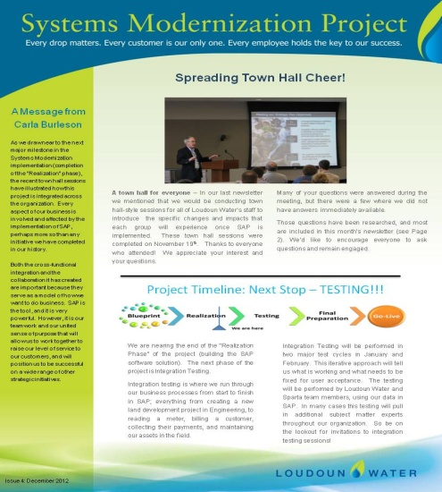


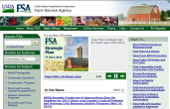

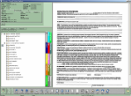
Training & Support Strategy
Vision: To prepare the End Users to perform their job tasks effectively in the new business process environment using the SAP application.
Purpose: To provide required supplemental support to the training plan, identifying training that can be provided early on to Super Users and End Users, increasing End User preparation for Go-Live, and assisting in the transition of help desk activities.
Phase 1: Overview
and Introductory SAP Foundational Learning
Phase 2: Pre-Requisite
Web-based & End User
Training Development
Phase 3: Instructor-led, Live Computer Training
Phase 4: Post Go-Live
Support
Increase End User and Super User Understanding of LW & SAP
Confirm End User Proficiency of SAP & Conduct Train-the-Trainer
Centralize Instructor-Led Training
Provide Support for End Users
Access to Hyper-care Resources
Self Help
Ask LW with Topic Areas
Performance Support
Share Best Practices
Training Schedule Functions
Knowledge Management
Search and Access Web Based Training
Create learning products for End Users and Super Users leveraging system and process developments on LW principles, basic SAP concepts, and key SAP terminology.
Provide training on basic SAP navigation and other key elements to End Users and conduct train-the-trainer in preparation for instructor-led training.
Facilitate a comprehensive facilities and logistics plan to ensure elements are in place for end user training.
Help Desk
Hint of the Day
Ongoing Help Desk Support
60 Day Training Team Support

Slide 26
Training Delivery
Multi-Dimensional Learning
A combination of delivery methods provide all types of learners access to a multi-dimensional integrated learning support solution for before, during and after the learning activity
Training will be delivered by SMEs and super users, supported where possible by functional team members
System User
Self-Paced and/or Online Training
Classroom/Coaching/On-The-Job
Simulations/Job Aids/Help

Slide 27
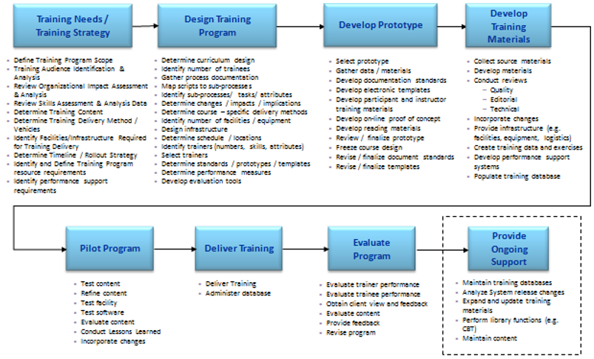
Training Development/Delivery Approach

Slide 28
Training Material Deliverables
What, whom, when, and how
Training materials are needed for ongoing support and sustainability within Loudoun water, and are comprised of:
  Business Process Procedures (BPPs)
  Instructor Presentations
  Simulations
Consulting partner will staff the project with three full time training developer resources, with one currently on board, and the others phased in during the Spring of 2014 to begin development

Slide 29
Business Process Procedures
What, whom, when, and how
BPPs are document aides used to guide employees through a designated transaction within a specified process area
BPPs are currently being created by the consultant Functional Team and reviewed/approved by their LW counterparts
To be used in activities during the life cycle of the project (e.g. During string testing, user testing, and pilot training), as well as for post go-live sustainability purposes
Will be posted on The Leak post go-live for easy accessibility

Slide 30
Instructor Presentations
What, whom, when, and how
Instructor presentations provide the structure and areas of emphasis to help guide the trainer and participants during instructor-led training
Created in PowerPoint, the materials specify what must be learned and include the course content and graphic explanations of processes and concepts as well as instructional activities
Presentations will be created by the consultant training developers beginning in the Spring of 2014 and reviewed/approved by the LW process area SMEs
Main usage will be during pilot and instructor led training, but will be available post go-live for sustainability

Slide 31
Simulations
What, whom, when, and how
Simulations are recordings of transactions that are presented to the user as a string of screen prints that appear as a simulated system environment
Simulations will be created by the consultant training developers beginning in the Spring of 2014 using Articulate, and reviewed/approved by the LW process area SMEs
Once complete, simulations will be accessible using the internal LMS, and can be reviewed by an LW employee on an as needed basis
Will also be used during the life cycle of the project for lunch & learn sessions, demos, and overview sessions

Slide 32
Instructor-Led Classes
What, whom, when, and how
Training classes serve as the basis for helping the LW end user population understand the need for and the reasons behind change, the ways in which the new system supports Loudoun Water’s strategic goals, and how the new system will support them in their jobs
Instructor-led training classes will begin in late August
Training classes will be conducted by LW process area SMEs and designated LW trainers; and supported by the consultant training developers
To prep LW resources for training, Train the Trainer sessions will be conducted in late July
Class size limited to approx. 15 end users

Slide 33
Course Name | Course Description | Course Objective
SAP Overview & Report Navigation | Provides an overview of SysMod and program objectives. Also provides information on how to manage the reporting process in SAP. | Describe SysMod and provide training on navigating reports in SAP
Inventory Management | Provides information on managing inventory in SAP. Review topics include: Material Pick List/Goods Issues, Cycle Counting, and Goods Receipt | Identify steps necessary to manage inventory using SAP
Maintenance Planner/Supervisor | Provide Maintenance Planners and Supervisors with information on how to manage planning responsibilities using SAP | Identify processes involved in managing the planning process in SAP
Customer Relations | Provides an overview of navigating IC Web and managing Business Partners in SAP | Recognize the system responsibilities necessary for IC Web and managing Business Partners in SAP
Billing | Provides information on managing the billing process within SAP | Explain billing activities performed in SAP
Managing Land Development Projects | Provides an overview of creating and managing Land Development Projects in SAP | Describe the process to create and manage Land Development Projects
Managing CIP Projects | Provides information on managing CIP Projects in SAP | Identify processes involved in managing CIP Projects in SAP
Procurement | Provides information on navigating and managing the SRM process within SAP | Identify steps needed to navigate the SRM process within SAP
Finance | Provides information on navigating and managing financial processes within the Loudoun Water organization. With its small group size, the Finance team will be provided with more one on one and personalized instruction | Describe the processes and procedures necessary to initiate and complete Financial transactions within SAP
HR/HCM | Provides information on managing employee processes using SAP. With its small group size, the HCM team will be provided with more one on one training, or instruction using simulations | Identify steps to manage the HCM process within SAP
EAM Fieldworker (Desktops) | Provides EAM Fieldworkers with information on managing work orders and creating notifications using SAP | Explain the steps necessary to create/close work orders and notifications

Slide 34
Questions?

